Slide 1
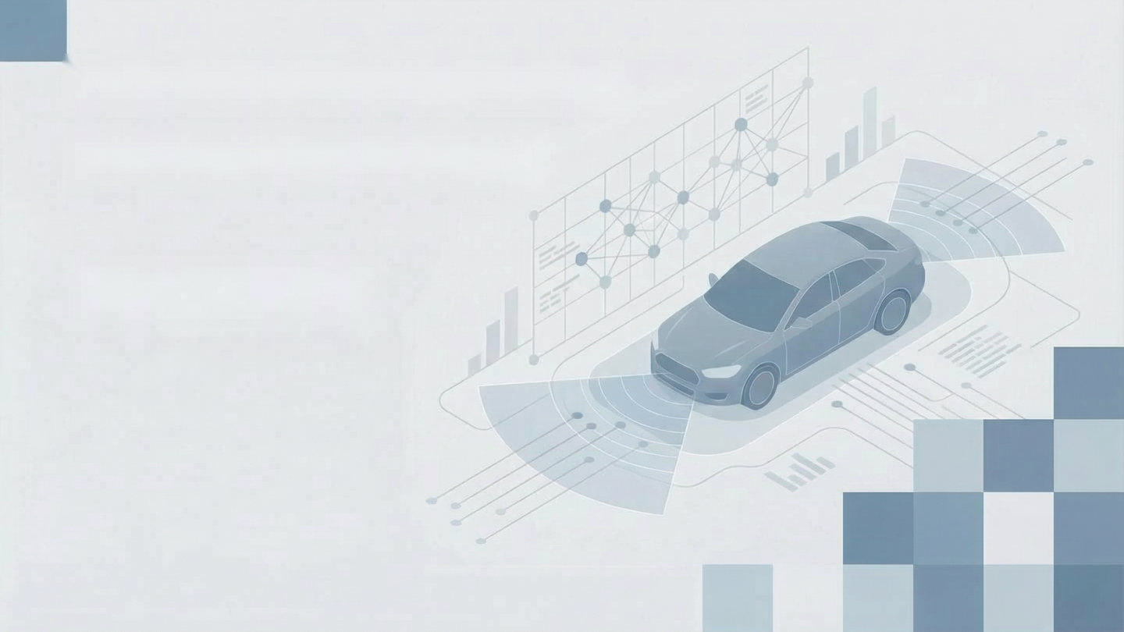
AI-Powered Collision
Avoidance System
Computer Vision for Autonomous Safety
Mariam nidal abdullah
Ahmed Khalid
Abdullah Moosa
Hisham Salahaldin Mahmod
Firew Borsamo Bosha
Binil Issac Johnson
Sarah Ateeq
Nabeeha Mubashir
Group 27 of the Samsung Innovation Campus

Slide 2
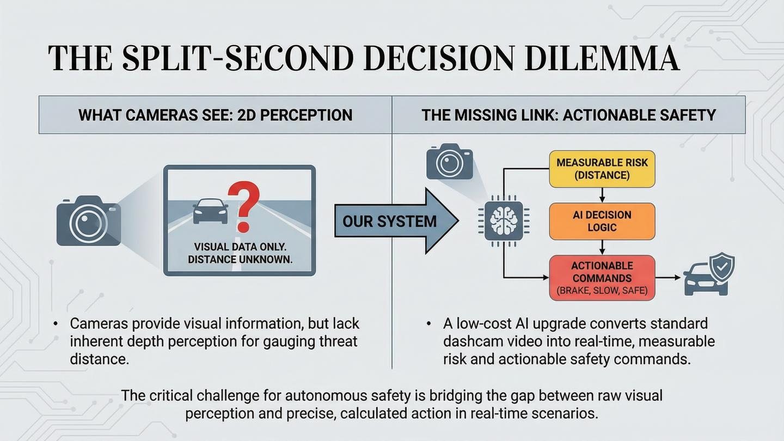

Slide 3
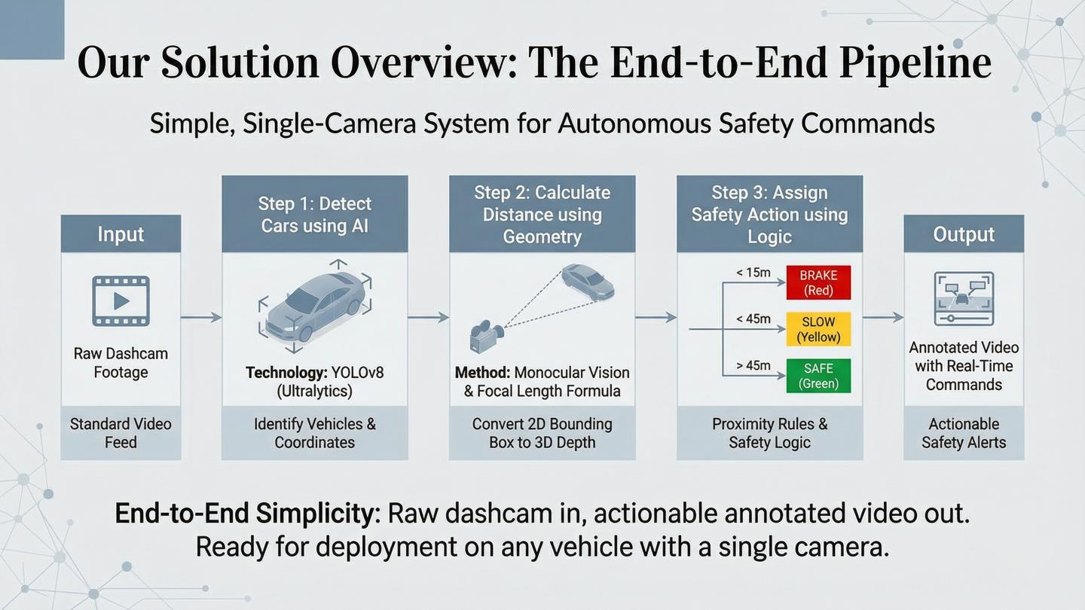

Slide 4
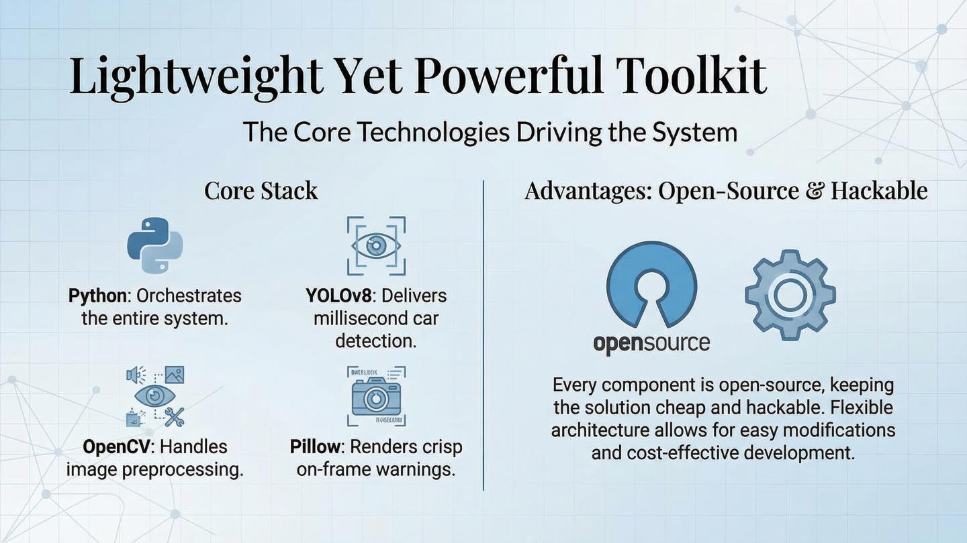

Slide 5
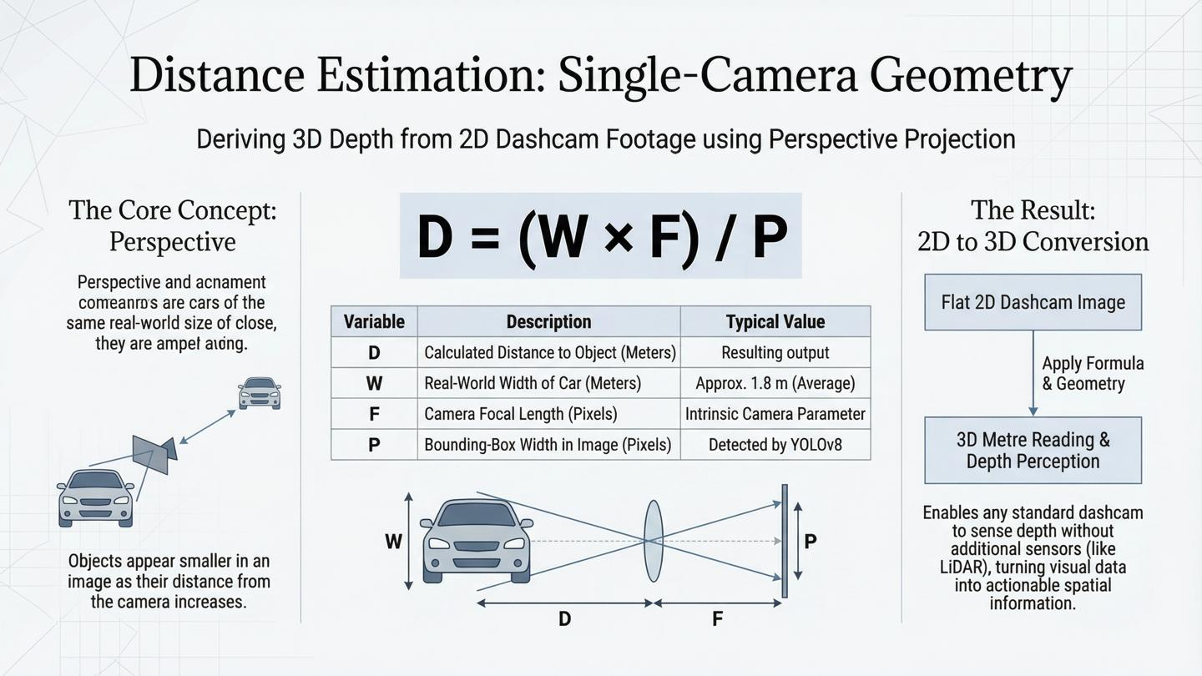
Apparent size is inversely proportional to distance

Slide 6
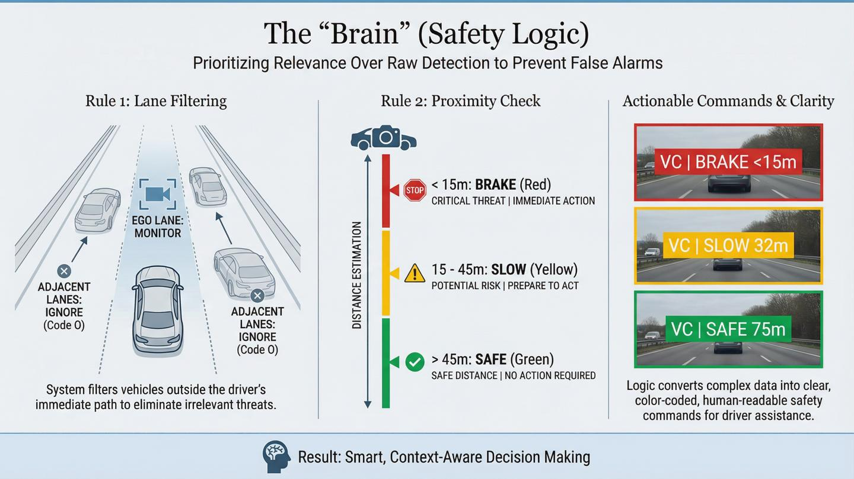

Slide 7
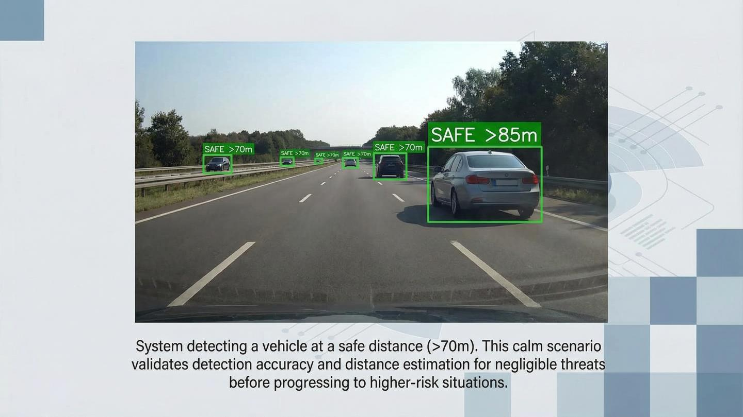

Slide 8
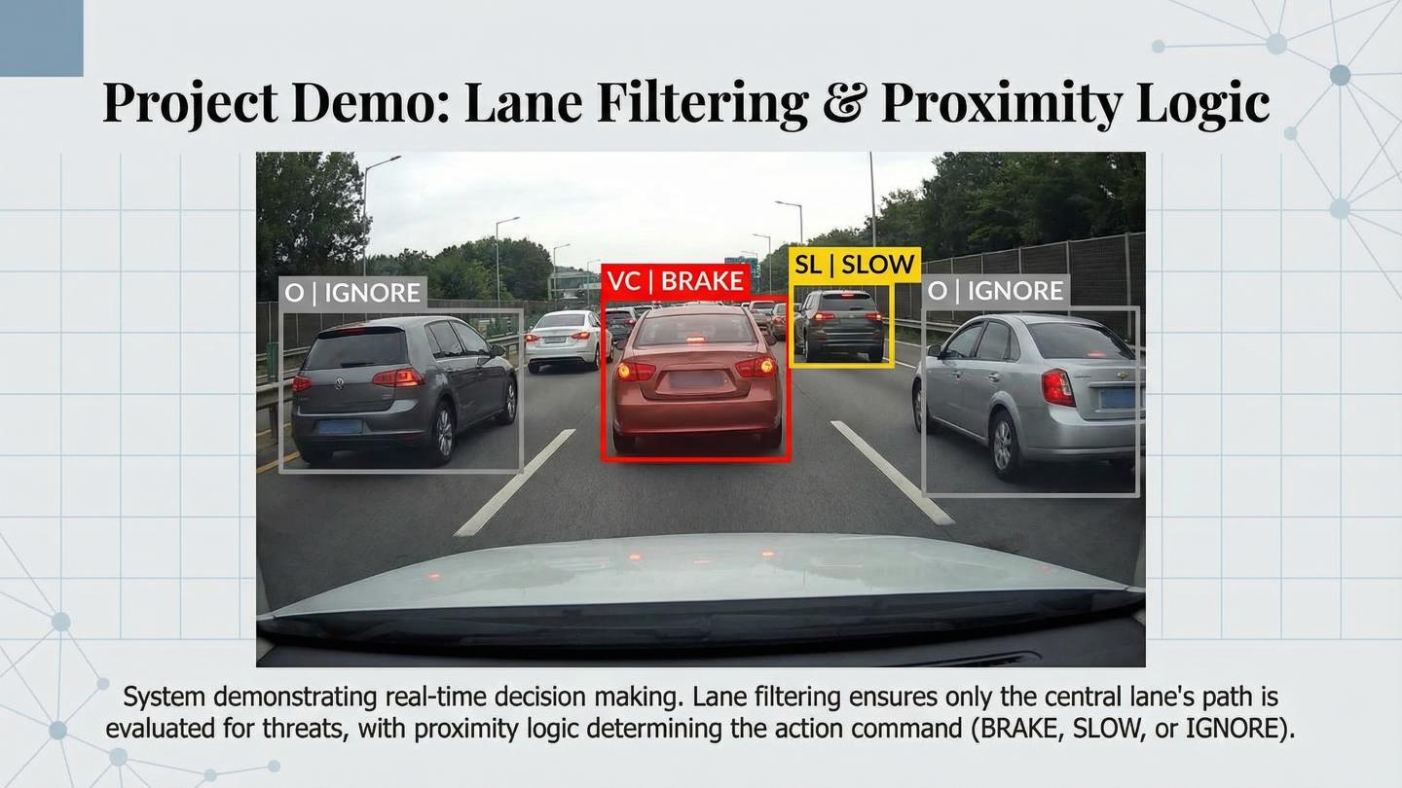

Slide 9
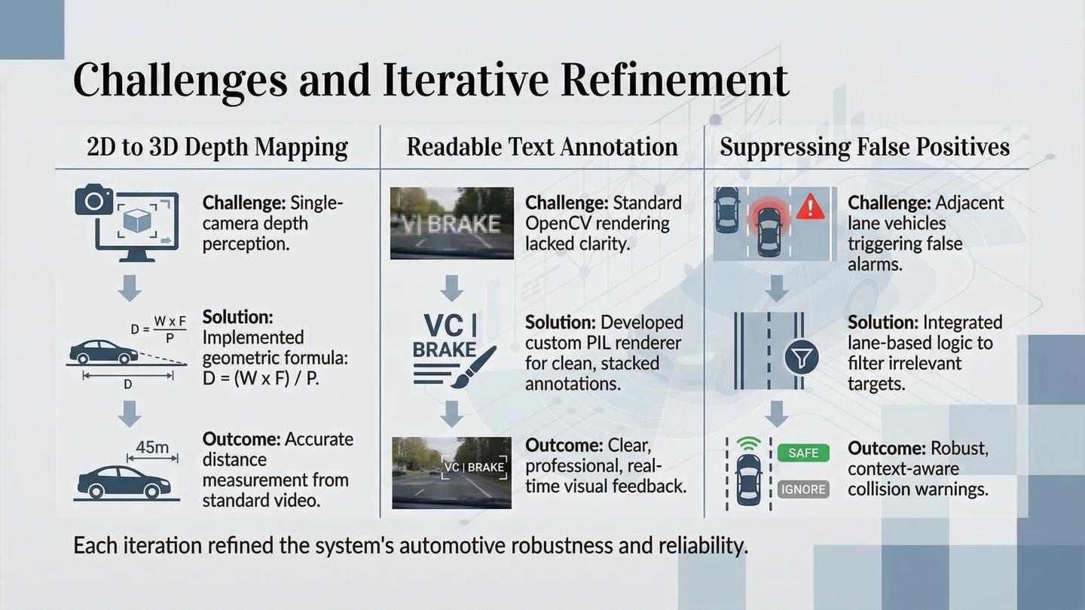

Slide 10
